Slide 1
Employer Branding
and how it can be a critical factor to attracting new talent!

Slide 2
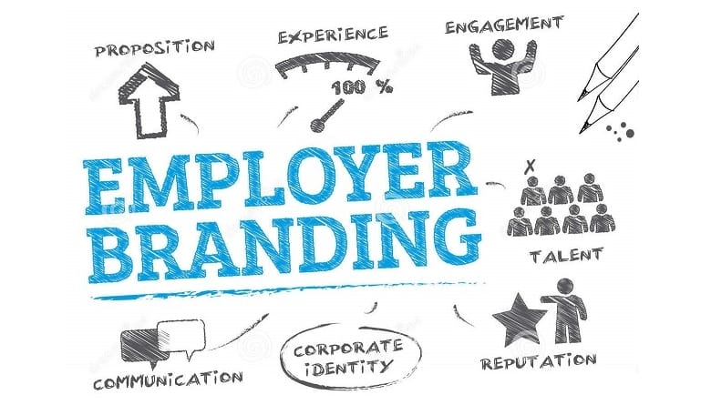
What is an employer brand?
The market’s perception of the company as an employer
Describes the promise to employees in exchange for their experience, talents, contacts, or skills.
How you market the company to desired job seekers.

Slide 3
Why is employer brand important?
Good employer branding will:
Spark buzz around the company = attract motivated job seekers = lead to happy employees.
Happy employees = broadcast their positive experience to open talent, clients, customers, and stakeholders
Collectively broadens the scope of employer brand: it lives in the minds and hearts of your former, current, and future employees.
In today’s increasingly competitive job market, a positive employer brand is critical. Without one, hiring and retaining the best employees becomes challenging and costly.

Slide 4
What are the benefits of a strong employer brand?
Twice as many applications compared to companies with unfavorable reputations
50% of workers said they wouldn't work for a company with a bad reputation, even with a big increase in compensation
Save money - an average of a $5,000 per employee
Recruiters and HR have to work much harder and much longer to bring in new hires when a company a weak employer brand = costly
But when top candidates want to work for you, recruiting costs drop by roughly 43%.

Slide 5
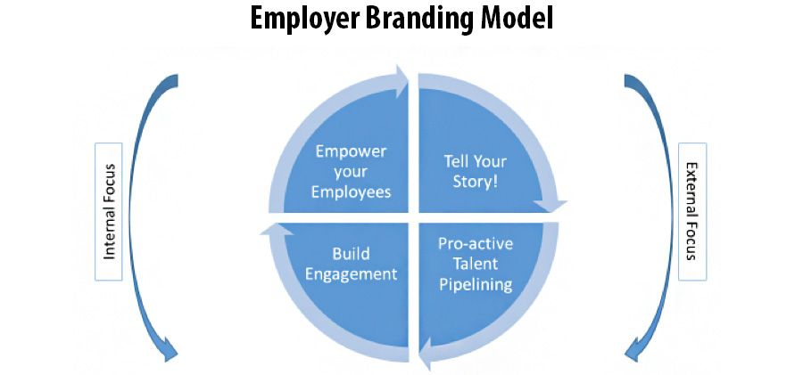
Build your brand
Crafting a strong employer brand is about good storytelling and using specific messaging to help attract the kind of prospects you’re looking for.
It’s also about living out that story. Satisfied employees are your loudest cheerleaders, particularly with social media and user-generated feedback, as this is where employers cannot control of their own reputation.

Slide 6
Value of an employer brand on social media:
90% of LinkedIn members say they’re are open to new job opportunities - all it takes is getting in front of potential candidates in compelling ways.
The more employees join conversations on LinkedIn, the bigger the opportunity for employer brand to grow. And when employees comment, like, or share news and opinions, they increase a company’s virtual presence.
Linkedin is where 59% of candidates go after hearing about a job opportunity, and learn details about the organization (candidates also love to creep on us recruiters!).
You can tell a company’s story and drive quality applicants to open jobs by customizing landing pages.

Slide 7
Using branding to attract candidates:
As you update your personal and professional profiles, be sure to post company news and to share job opportunities.
The average network size of a company’s employees is 10x larger than its own = employees are the unofficial recruiters and marketers of the employer brand.
Advice for a client: The 1st step of a good employer brand strategy is to encourage employees use LinkedIn to represent themselves and spread the word about your company.

Slide 8
Using branding to attract candidates:
The first 90 days of employment are critical to turning a new team member into a productive employee.
Advice for a client:
A company can make a lasting first impression with a smooth onboarding process.
Arm new hires with tools, introductions, and orientations
Offer training and advancement opportunities - nothing saves recruiting costs more than promoting from within
Job posts are often the first contact candidates have with your company, so they’re a perfect way to promote employer brand.

Slide 9
What is an employee value proposition (EVP)?
An EVP encompasses an organization’s mission, values, and culture, and gives employees a powerful reason to work. It’s everything a company can offer as an employer, in exchange for all the skills and experience employees bring to the table.
Strong EVP:
Attract and retain the best people
Help prioritize goals/agendas company-wide
Re-engage a dispassionate workforce = reduce hiring costs.
Most of all, it contributes to a favorable and robust employer brand!

Slide 10
How to market your careers from a client company standpoint:
Think about the internal marketing of the company:
How a company “sells” itself to one of its largest groups of stakeholders — the employees.
Often focuses on convincing employees to believe in the company philosophy or mission, thereby improving how engaged they are with their work.
A key component to this is fully supporting the client company’s approach to business or plans for the future.

Slide 11
Understanding a client’s internal marketing:
What are company’s long-term goals and values?
Mission statement?
Ask about employee input on corporate policies or leadership
Can also do research on sites like GlassDoor
How does the company nurture communication and collaboration among employees?
How does the company ensure that employees know their contributions matter and are essential to the company’s success?

Slide 12
Proof that internal marketing matters:
Brand messages reached 561% further when shared by employees vs the same messages shared via official brand social channel!
Researchers at Gallup found that only 15% of workers are actively engaged in their jobs and that the behaviors of highly engaged business units result in 21% greater profitability.
Good internal marketing = engaged employees = more profit

Slide 13
The big picture
Understanding a company’s employer branding will make your recruiting efforts more successful.
How you “sell” a role to potential candidates should align with a company’s internal marketing strategy.
As an employee of Sci.bio and our clients, Linkedin is a valuable asset. You can not only build a personal brand as a recruiter, but also promote the employer branding of your partner companies.

Slide 14
Sources
https://www.linkedin.com/business/talent/blog/talent-acquisition/employer-branding
https://everyonesocial.com/blog/internal-marketing/
https://www.forbes.com/sites/forbesbostoncouncil/2019/08/05/internal-marketing-what-it-means-and-why-its-important/?sh=56008d9d4086

